Slide 1
SUSTAINING A BUSINESS AND MAKING PROFIT AS A STUDENT
Akinyemi Abisola Deborah
Notes:
1
1

Slide 2
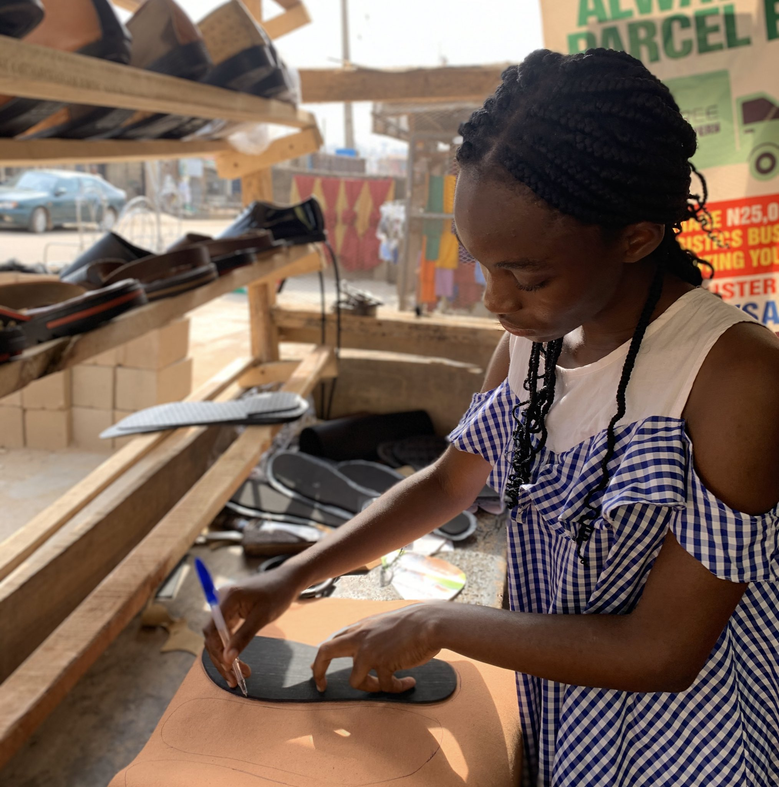
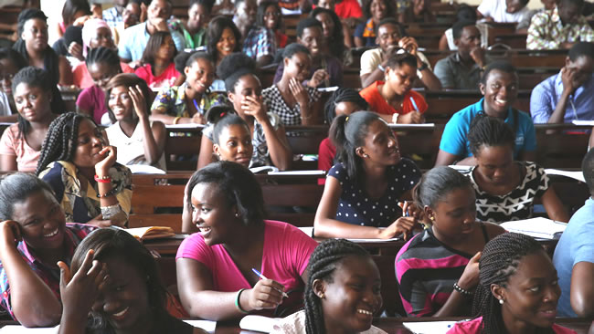
Student
Business Owner

Slide 3
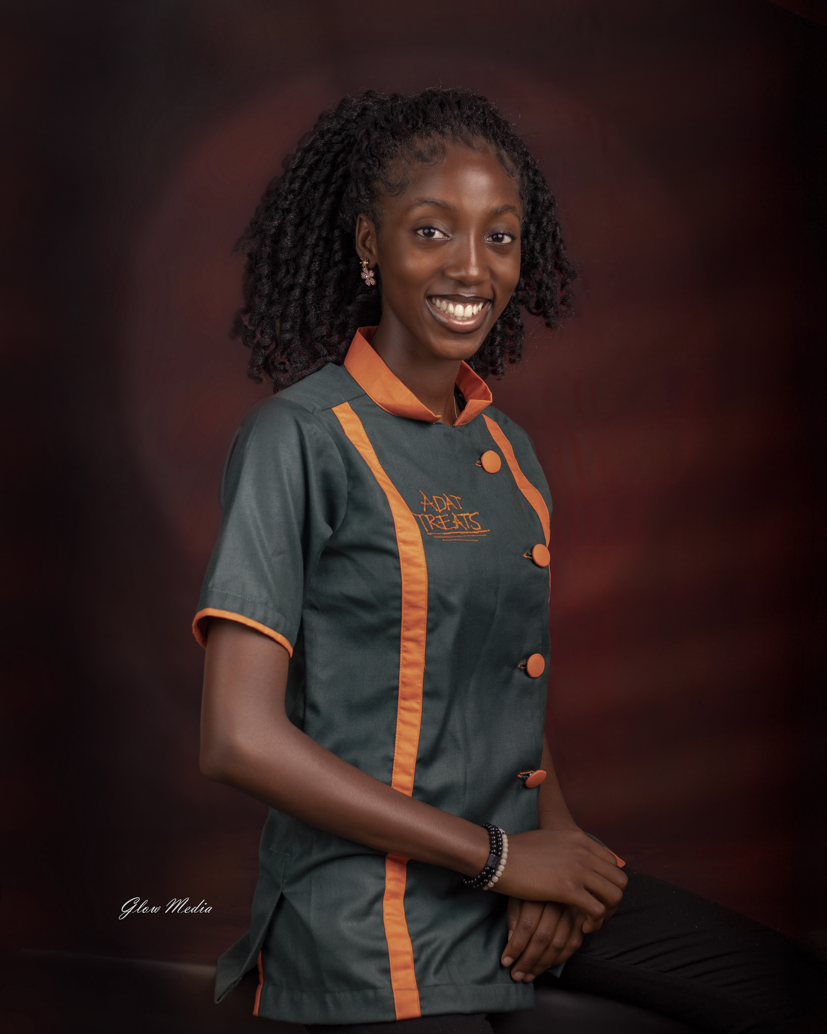
MEET ABISOLA
Abisola is the Creative director of ADAT Treats and a 400 level student of English Language at University of Ilorin. She started her baking business in 100 level at the age of 16 and is building a budding global brand business, serving clients not only in Nigeria but outside the country.

Slide 4
Questions to be answered
Question two How do I get Customers?
Question one How do I break out into an already saturated market?
Question 3 Most recently, how can I sell using social media?

Slide 5
Question THREe: HOW CAN I SELL USING SOCIAL MEDIA? Answer:
Look for the right platform
Open your account
Optimise your account
Create valuable content consistently
QUESTION TWO: HOW DO I GET CUSTOMERS?
Answer:
Rigorous and Intentive awareness
Create irresistible offers
Consistent and Persuasive advertising
3
2
1
Question one: How do I break into an already saturated market? Answer: Have a Niche.

Slide 6
7 Tips for an excellent student-preneur
Make up your mind to excel in both (Your studies and business)
Create quality products and have exceptional customer service
01
05
You are not a regular business owner; there must be a balance. Learn to say NO to some orders
Get help; leverage on people around you
02
06
Leverage on your studentship and make some noise
07
Involve God in everything you do
03
04
Create exciting offers often

Slide 7
Business Affirmations
I have a sound and clear mind to make the right decisions for my business and academics.
I attract great opportunities and I'm prepared to Maximize them
I am excellent in business and academics
I have what my customers need
My business solves problem and I get paid in return
6. I receive the grace to say NO to deals that'll affect my academics
7. I'm sensitive to discern great opportunities in hard times and maximize it for my wealth
8. I leave every client happier and better than I met them
9. My business is God's business. My Academics is God's, too.
10. I attract the audience meant for me.

Slide 8
Farewell
Dear Student-preneur,
You’ve got this. Your business will thrive. Your academics won’t suffer, you will sail through.
I am rooting for you.
I am ABISOLA, a Light bearer from Zion and my Origin is an advantage.

